Slide 1
Administrator Application
Developed by James Hunt

Slide 2
Summary of application
Allows the admin to perform routine tasks.
These tasks include the data maintenance of all data within the database.
Allows admin to view passengers and staff members.
Allows admin to view bookings made by passengers.
Securely implemented with sessions, SHA256 encryption and salting.

Slide 3
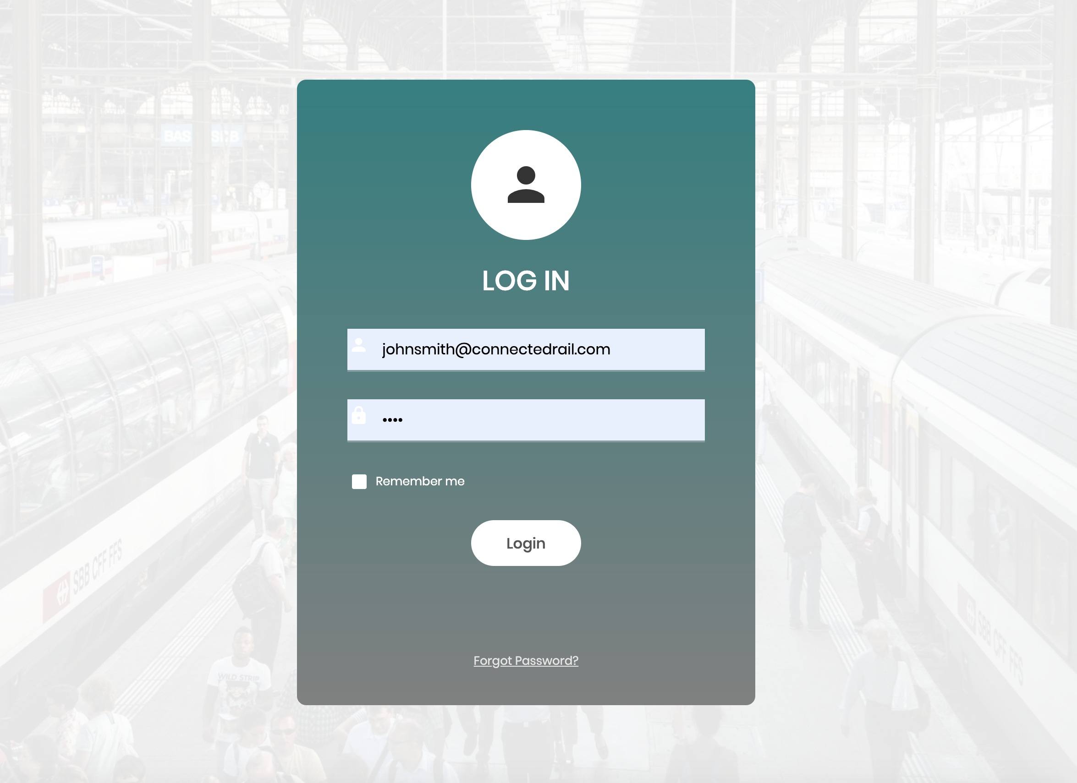
Login

Slide 4
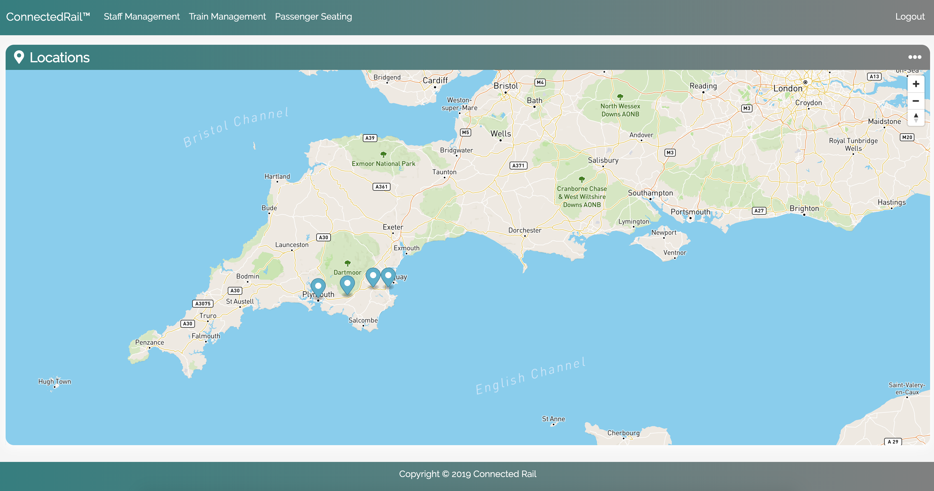
Home page – Locations Summary

Slide 5
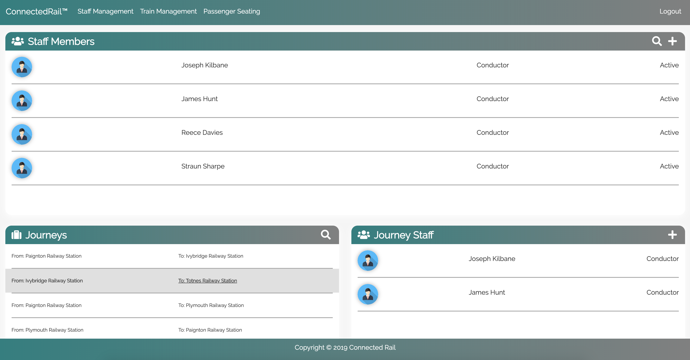
Summary of staff & journey staff

Slide 6
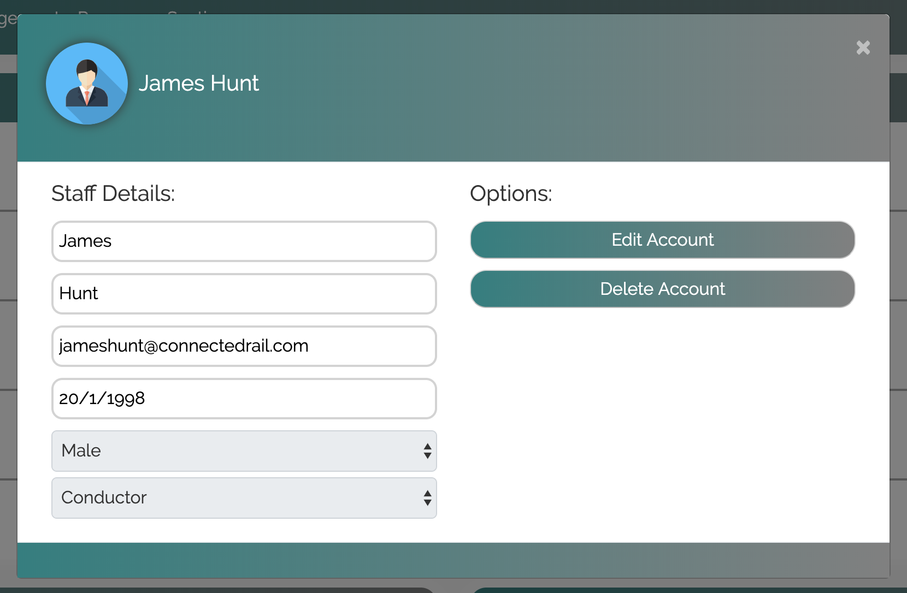
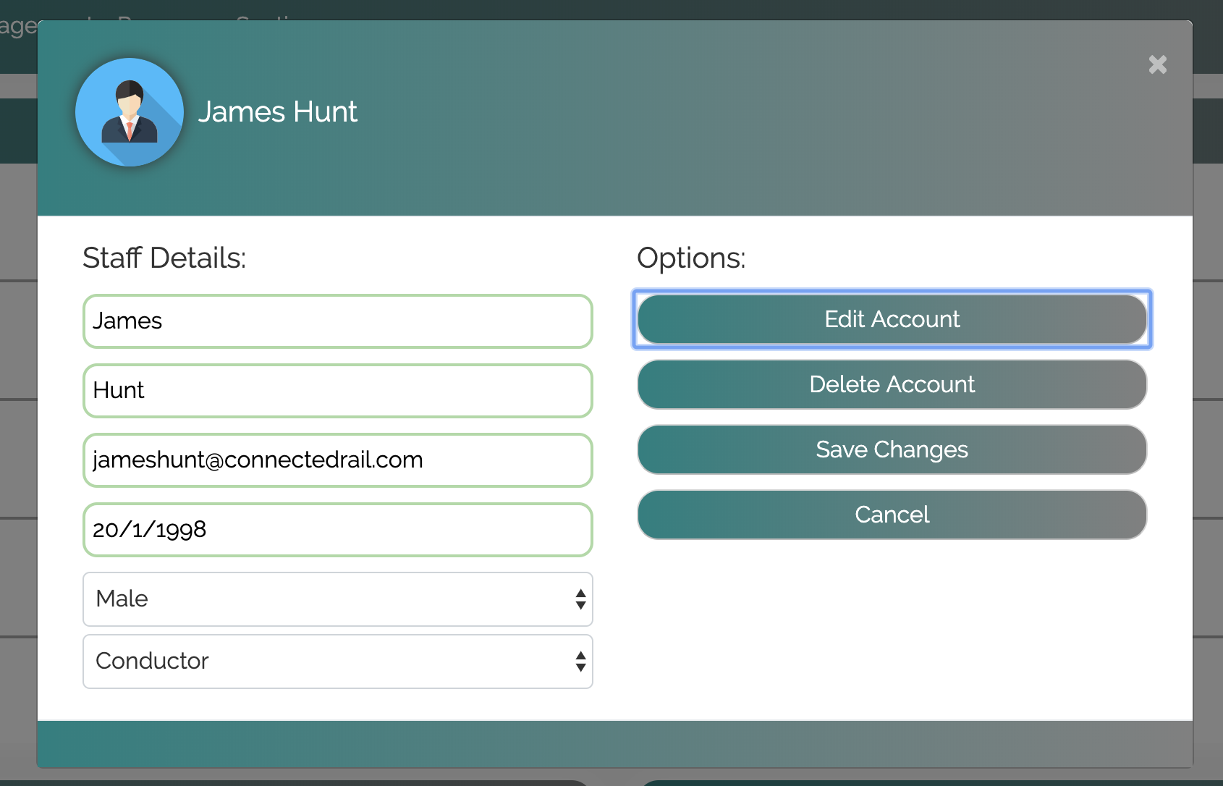
Updating staff data

Slide 7
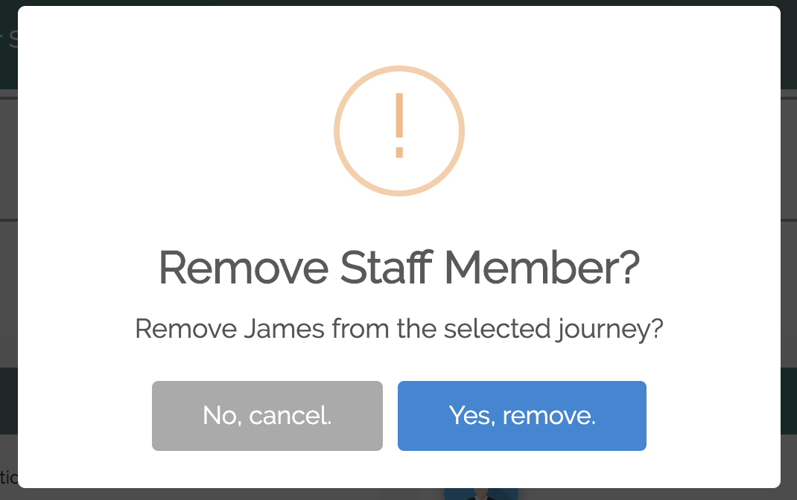
HCI – Alerts and Easy Reversal of Actions

Slide 8
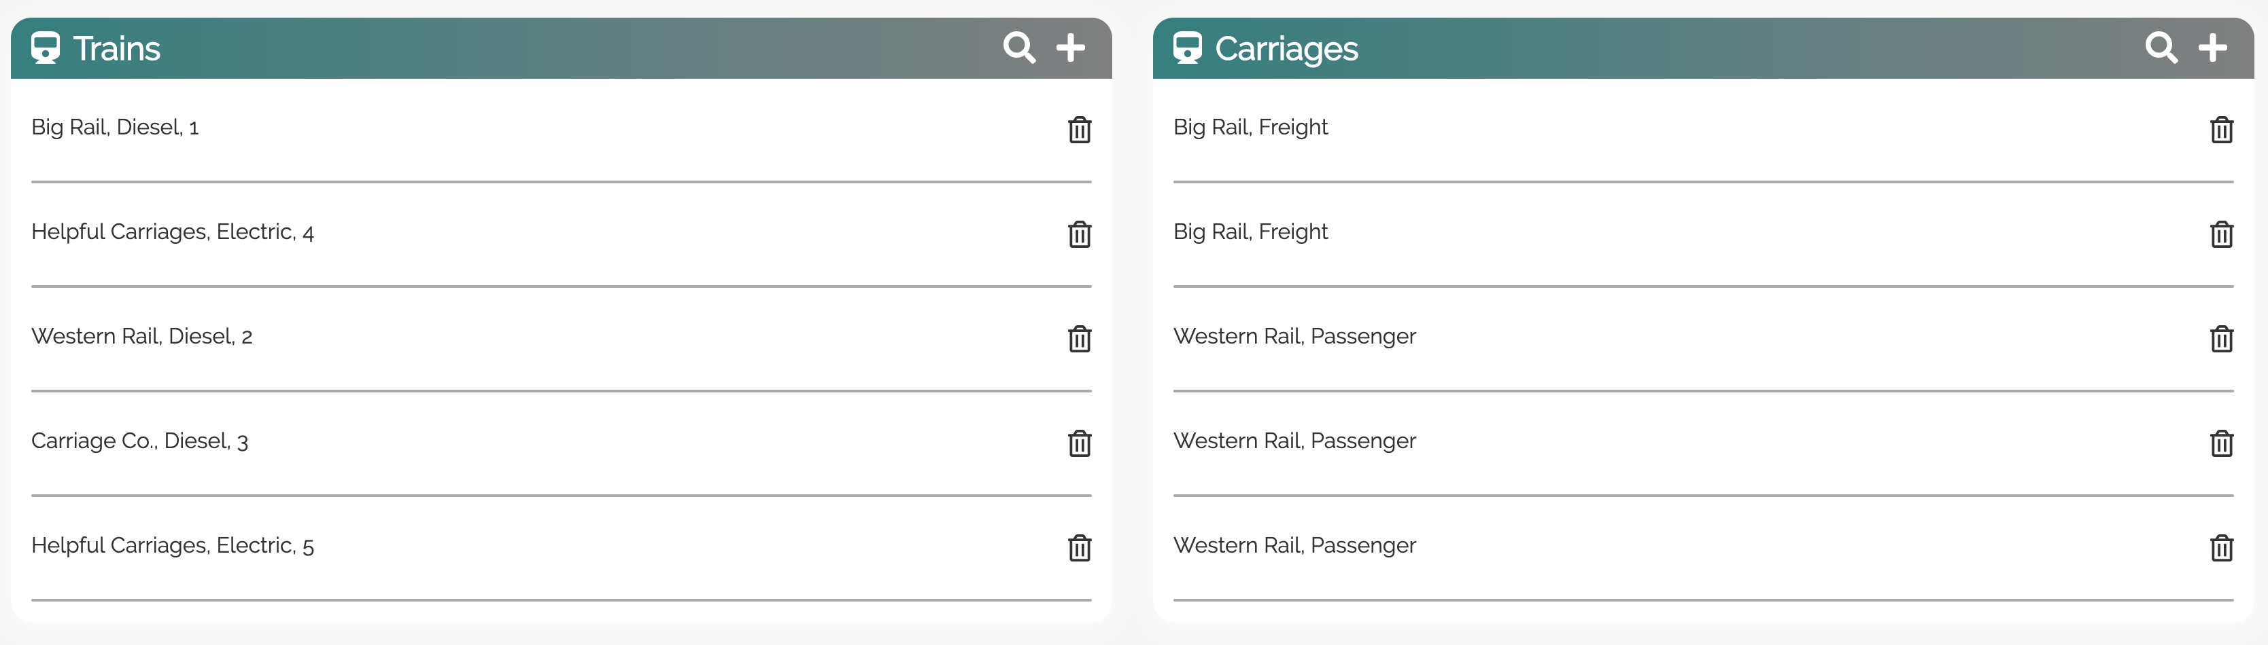
Train Management

Slide 9
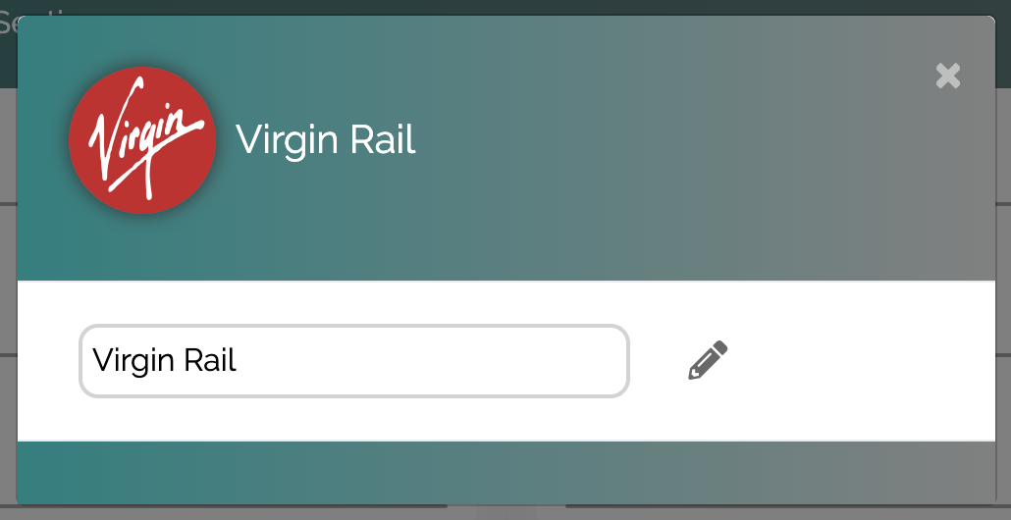
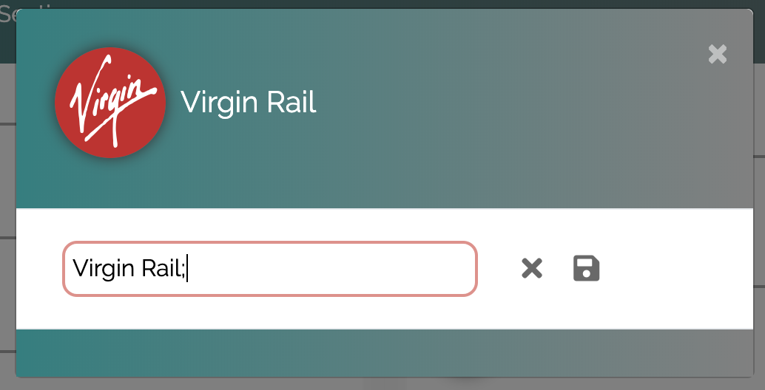
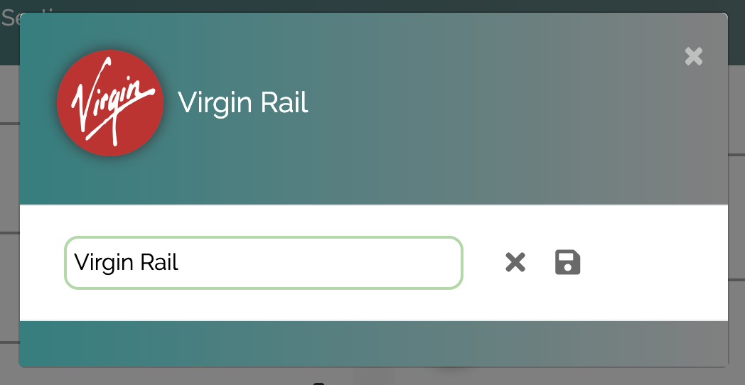
Client Side Validation & Protection

Slide 10
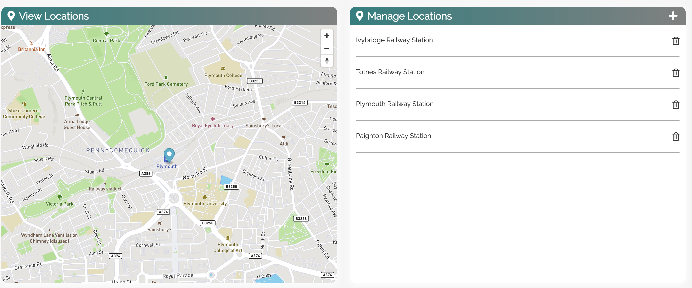
Location Management

Slide 11
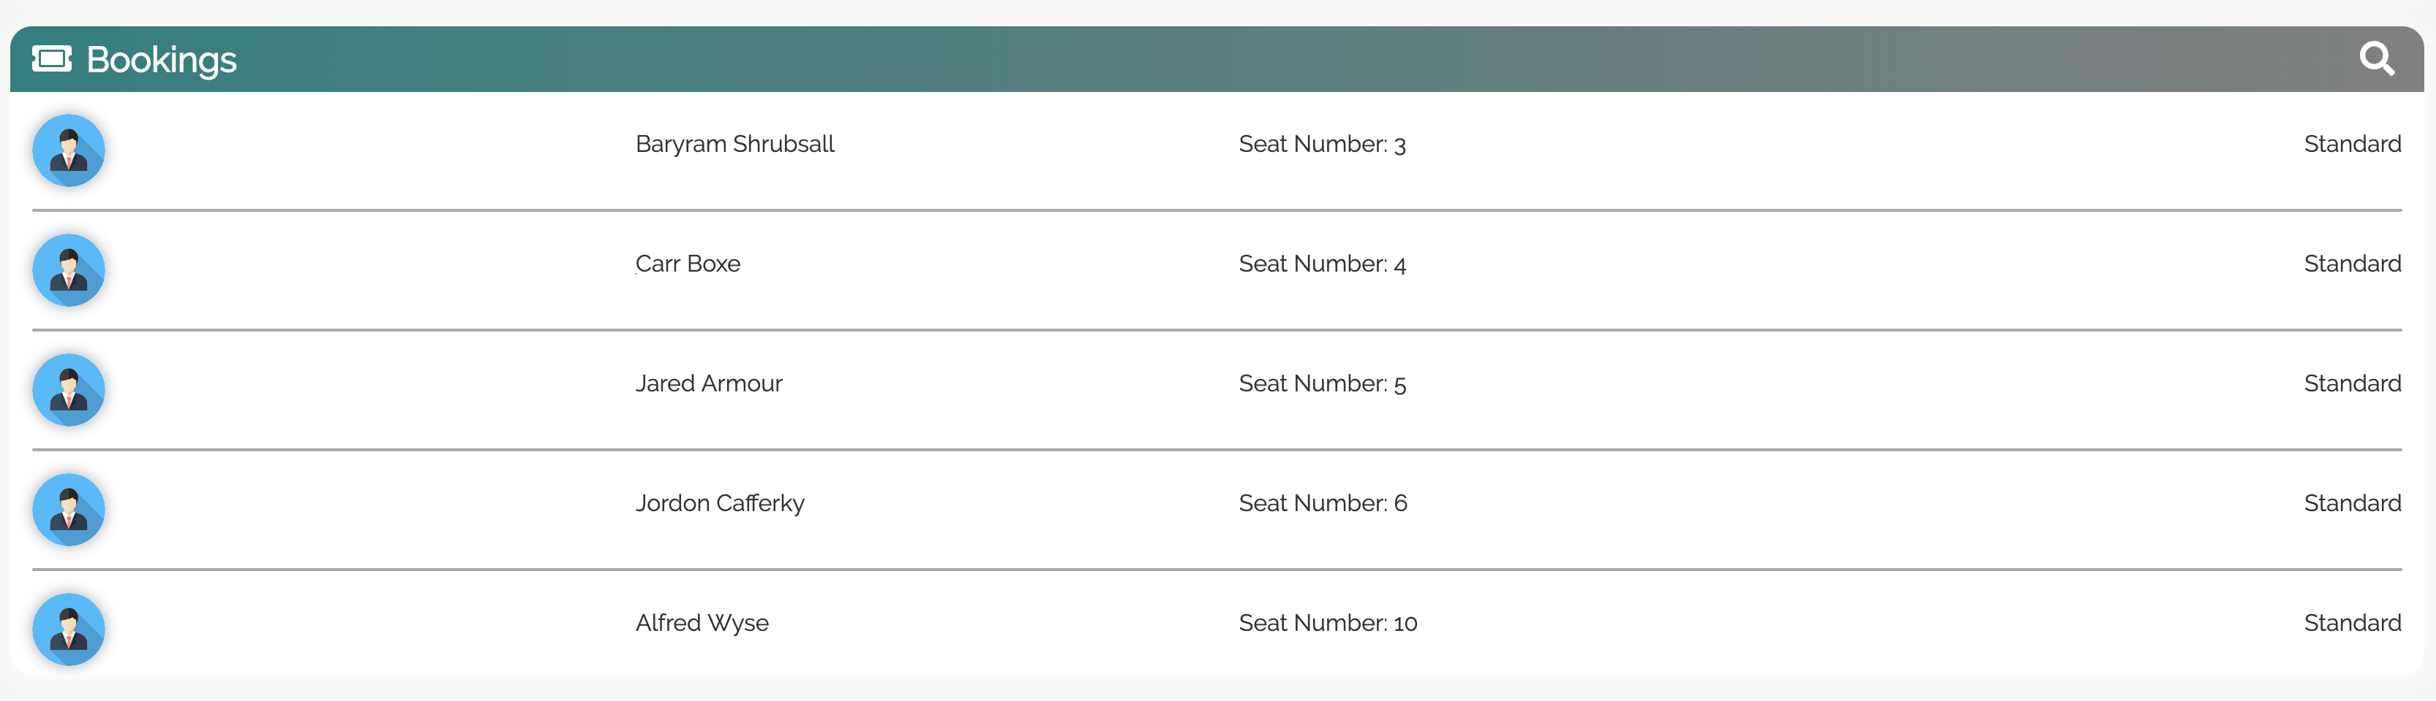
Booking & Passenger Management

Slide 12
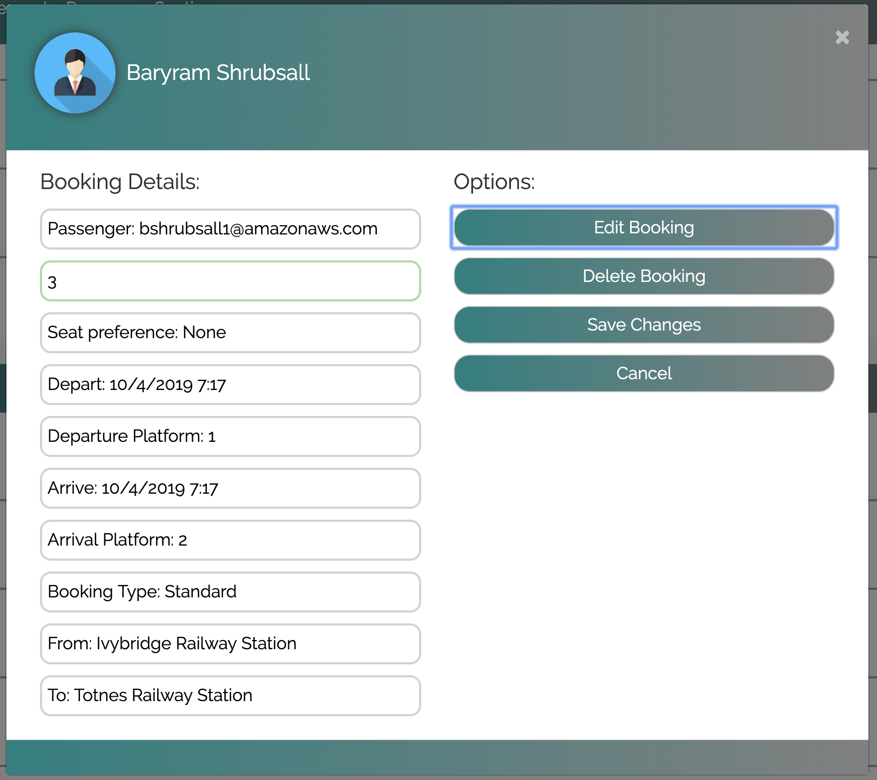
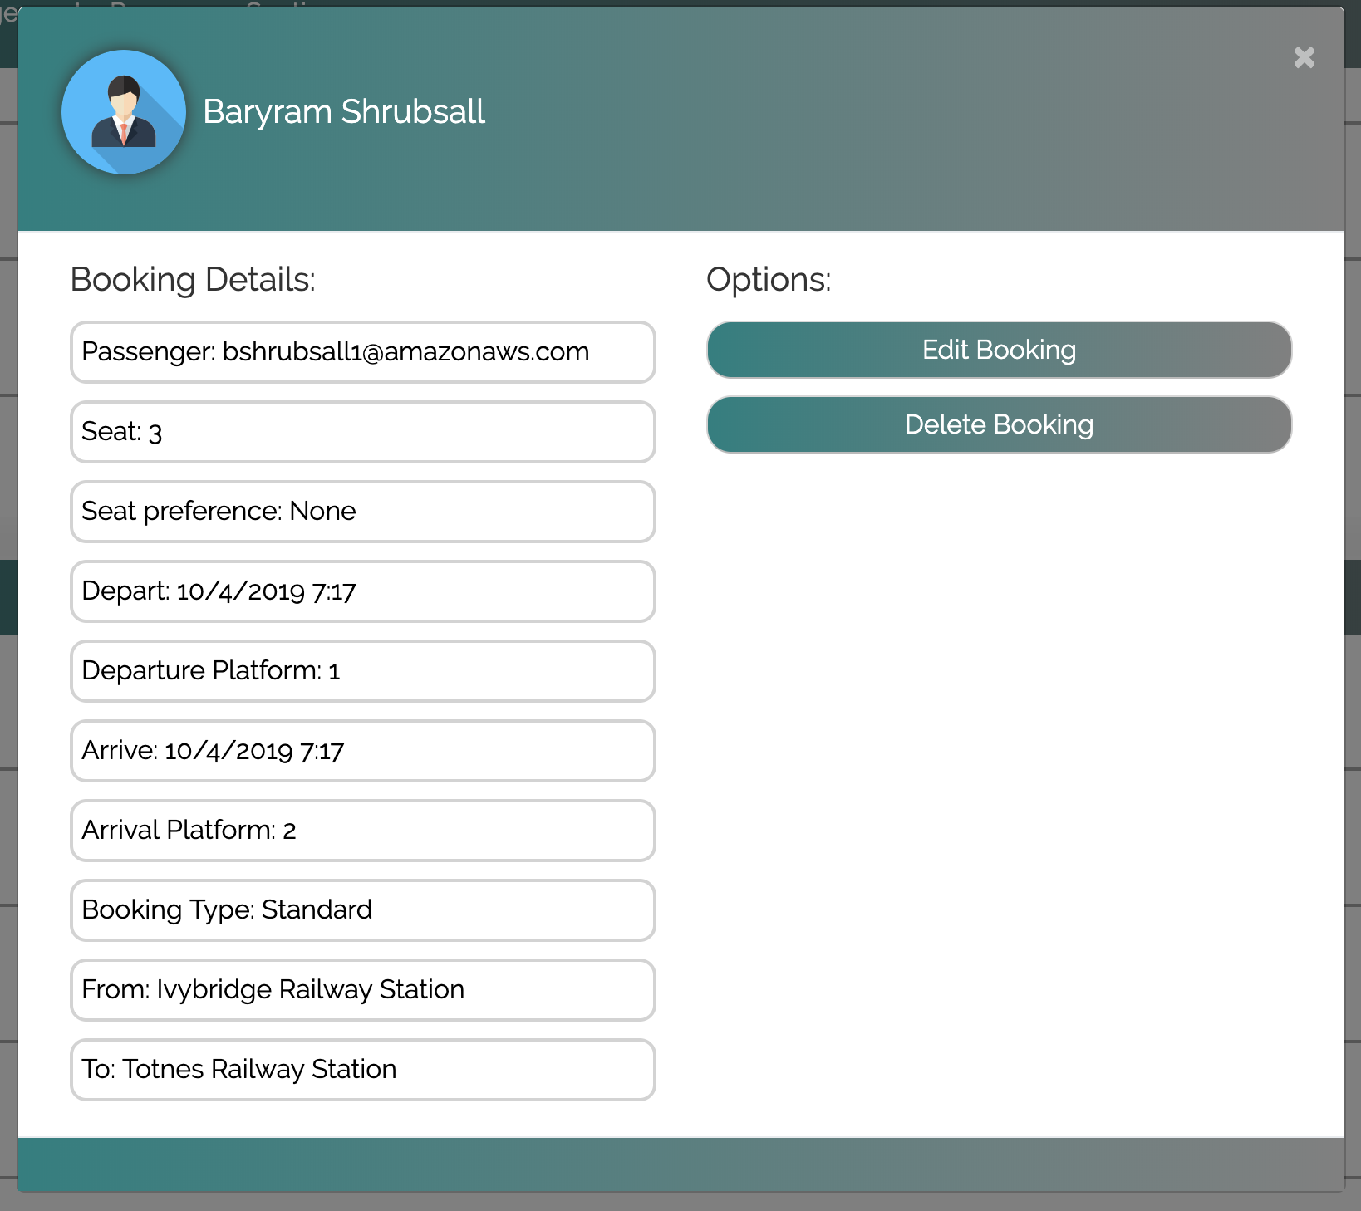
Updating Passenger Seats

